Slide 1
Backpropagation
Lecture 16

Slide 2
Resources
Directly using these notes: https://365datascience.com/trending/backpropagation/

Slide 3
Friday, September 20th
National Fried Rice Day
National Pepperoni Pizza Day
National Punch Day
National String Cheese Day
National Queso Day
World Paella Day
National Coding Week

Slide 4
Backpropagation

Slide 5
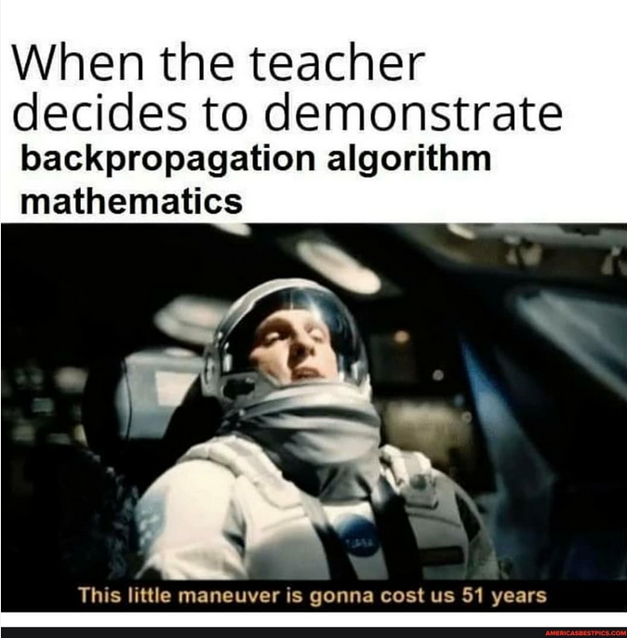
https://americasbestpics.com/tags/backpropagation

Slide 6
Backpropagation
Neural networks are supervised learning
Remember the goal of creating a good supervised learning model
  Find the model parameters
  That generate the minimal possible output error
So our process while training the model is:
  Figure out the error of the model at it's current parameters
  Figure out how to change the parameters to get better results

Slide 7
Layer 2
Layer 3
(Output)
101
Layer 1
Betty
Betty's info
Input
Cheese
Or
Pepperoni
45
Box
Weight: 1
Frank's info
0.3
Frank
Clint
Clint's info
Dave
Greasiness
%: 20
27
Helen
Helen's info
16
Emeril
Emeril's info
Deliveryman
Master Chef Layer
Cardboard Experts

Slide 8
Error
The output of the network was not necessarily correct
You can calculate the error of a network guess with any applicable error function
Lots of options – similar to our tabular data
However, turning the error into a better network is a whole process
We will talk about that next time!

Slide 9
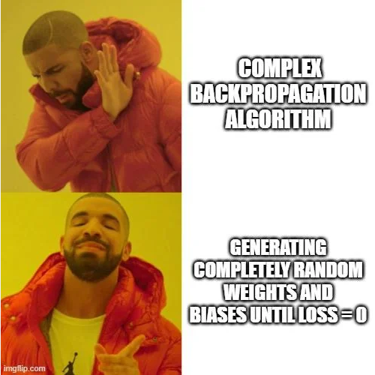
How do we change our parameters to get better results?
https://www.reddit.com/r/ProgrammerHumor/comments/1c9b4mq/iwroteanalgorithmtodaythatcouldbestbedescribedasbo/

Slide 10
M = 0, B = 0, Error = 10
Error
M = 1, B = 2, Error = 9
M = 5, B = 5, Error = 5
M =1, B = 9, Error = 3
M =9, B = 1, Error = 2
M =2, B = 7, Error = 1
M
B

Slide 11
How do we change our parameters to get better results?
We could do it randomly
  If you are really lucky, this might even work the best
  But not likely
Or we could use something more sophisticated, like gradient descent (much like in other models)

Slide 12
What do we do in gradient descent?

Slide 13
What do we do in gradient descent?
We take the derivative of the model error with respect to the parameter

Slide 14
What do we do in gradient descent?
We take the derivate of the model error with respect to the parameter
Great plan!

Slide 15
What do we do in gradient descent?
We take the derivate of the model error with respect to the parameter
Great plan!
Implementation can get ... complex

Slide 16
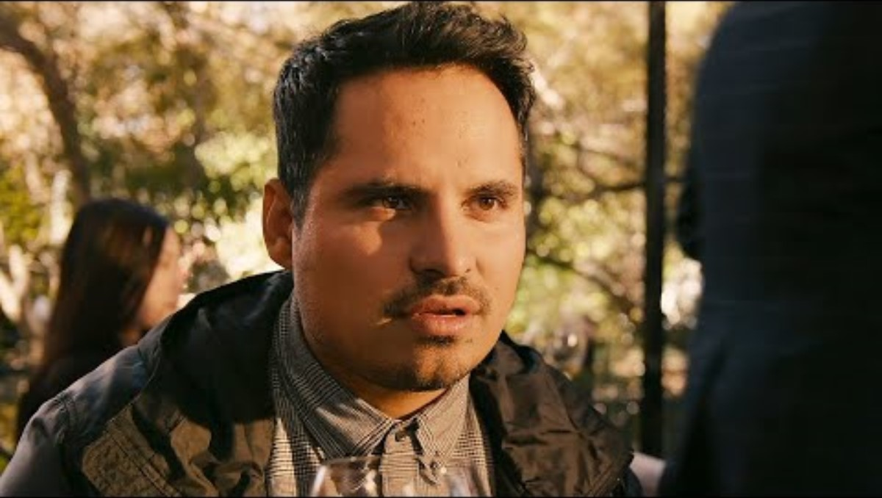
https://youtu.be/UyV_38fmgOc?si=WPPfT4UPH-BXz8bO

Slide 17
Connections
Understanding the derivate of a given parameter with respect to the network error is all about understanding the connections
And the underlying math itself is not terribly difficult
  Notation is confusing
  Understanding all the pieces that should be included is also confusing

Slide 18

Local Minimum
Less optimal step size parameter
Better Local Minimum
More optimal step size parameter
Global minimum
May not reach

Slide 19
Notes
Buckle Up

Slide 20
Errors
MSE – L2 Norm
MAE – L1 Norm
Batches for gradient descent

Slide 21
Potential Pitfalls
What would happen if all neurons were initialized with the same weights/biases?

Slide 22
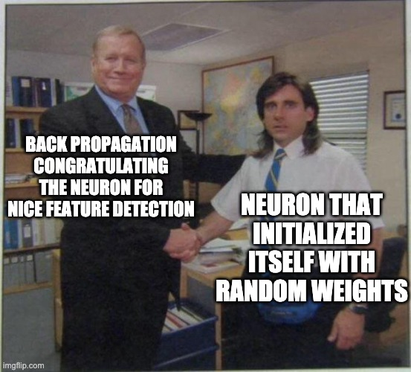
Potential Pitfalls
What would happen if all neurons were initialized with the same weights/biases?
  Random initialization
Vanishing and Exploding Gradient
https://imgflip.com/i/5fxnuz

Slide 23
Potential Pitfalls
What would happen if all neurons were initialized with the same weights/biases?
  Random initialization
Vanishing and Exploding Gradient
Mislabeled example
https://imgflip.com/i/5fxnuz

Slide 24
Questions?

